Slide 1

Car Rental Management System
Submitted to –
Mr. Rajiv Chourasiya
Presented By –
Durgesh Pathak & Ajeet Kumar
22SCSE1012981 22SCSE1012974

Slide 2
Introduction
It is an online system through which customers can view available cars, register, view profile and book car.
Nowadays, most of the people prefer car for their trip, Because car journey to any trip with our family or friends gives happiness and makes us to feel comfortable.
People can choose the car that’s suits best for their need according to size, comfort and price.
People can book in advance or cancel it whenever required.
2

Slide 3
Admin Module
Admin can create vehicle brands
Manage Vehicle Brands ( Edit, Delete )
Admin Dashboard (Admin can view the count of reg users, total booking, total subscribers, total queries, etc)
Change Password ( admin can change password on its own )
Manage vehicle ( Edit, Delete )
Manage Booking( Admin can confirm and Cancel Booking )
Manage to Contact us Query
Admin Can the details of registered users
Admin can also update the page content
Admin can update the contact us details
Manage Subscribers
Mange Logout
3

Slide 4
User Module
View car booking history
Update his/her profile
Update his/her password
Change booking date and time
Different payment options
Help and support
Car booking
Logout
4

Slide 5
Advantages
This online car rental solution is fully functional and flexible.
This online car rental system helps in back office administration by streamlining and standardizing the procedures.
It save a lot of time, money and labour.
It provides custom feature development and support with software.
The software acts as an office that is open 24/7.
5

Slide 6
Feature scope
Automation of the entire system improves the efficiency
It provides a friendly graphical user interface which proves to be better when compared to the existing system.
It gives appropriate access to the authorized users depending on their permissions.
It effectively overcomes the delay in communications.
Updating of information becomes so easier. System security, data security and reliability are the striking features.
The System has adequate scope for modification in future if it is necessary.
6

Slide 7
Concepts Used
Concept of class and object
Class inheritance
If else statements
File handling
While statements
Setwidth
Sleep function
System CLS function

Slide 8
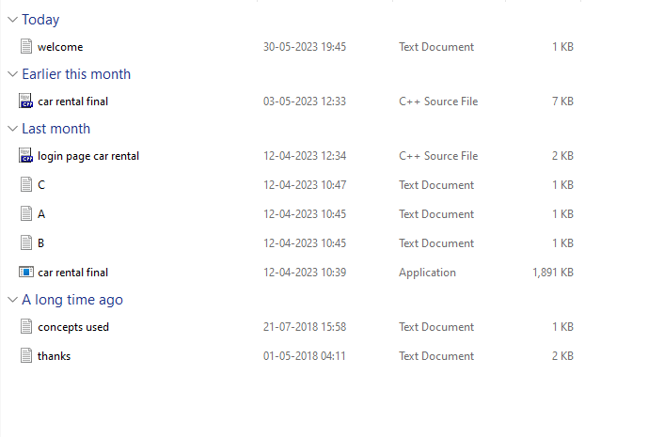
Working of Project
These are the text files used in the project through file handling

Slide 9
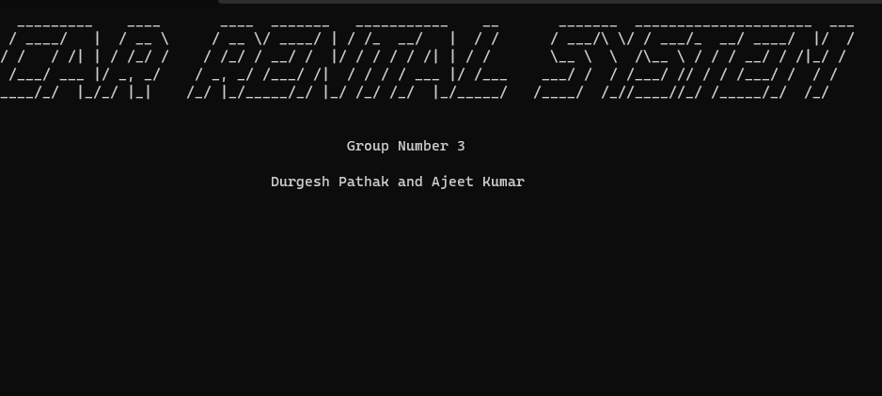
Working of Project
When “car rental final.exe” is clicked, the project starts and “welcome.txt” is called through file handling. All the components which were in “welcome.txt” file are displayed in the project.

Slide 10
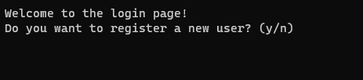
Working of Project
After opening the “welcome.txt” file, the project takes us to the login page. Here an existing user can login or a new user can be registered.

Slide 11
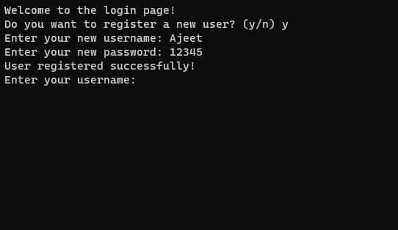
Working of Project
Here, a new user can be registered by selecting “y”. Here we have entered a new user name “Ajeet” and a new password for this user name “12345”. Then the registration of the new user is successfully done.

Slide 12
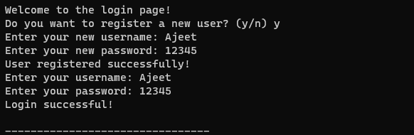
Working of Project
Now, we are logging in using the user name “Ajeet” and password “12345”. The login is successfully done.

Slide 13
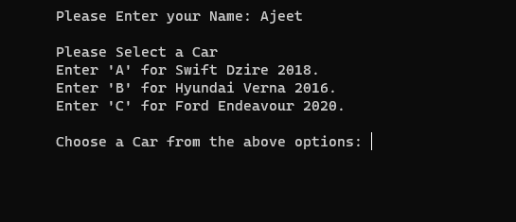
Working of Project
After logging in the project takes us to the car selection page. Here three car options appear, they are “A” , “B” , “C”.

Slide 14
Working of Project
Here “A” option is for the car “swift dzire 2018”. “B” option is for car “Hyundai Verna 2016”. “C” option is for car “Ford Endeavour 2020”.
When the option A is selected then the “A.txt” is called through file handling.
When the option B is selected then the “B.txt” is called through file handling.
When the option C is selected then the “C.txt” is called through file handling.
The “ A.txt, B.txt, C.txt ” files are stored in the project directory.

Slide 15
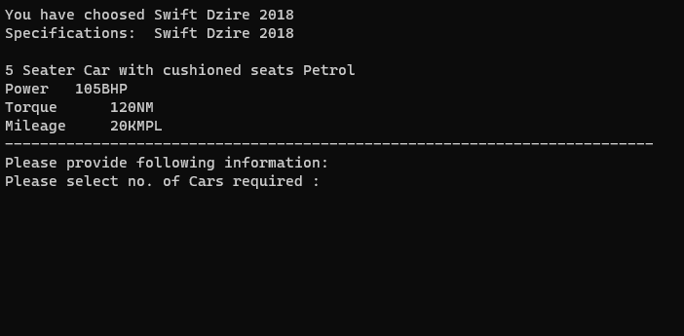
Working of Project
Here, we have selected option “A”. The components which were stored in the text file “A.txt” are displayed in the project

Slide 16
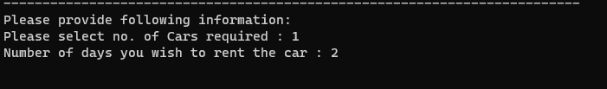
Working of project
After selecting any of the options from “A,B,C” The project takes us to the page where we have to provide information related to the car. The information which we have to provide are-
Number of cars required
Number of days you wish to rent the car

Slide 17
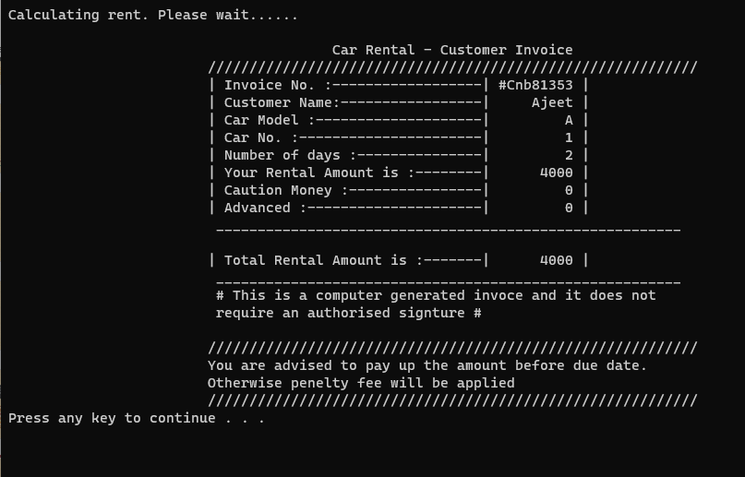
Working of project

Slide 18
Working of project
After selecting the total number of cars required and the total number of days for which the car/cars are required, the project calculates the total rent for the given inputs.
After calculating the rent price, the project displays the bill for the given inputs.
The project is executed successfully and the desired output is displayed.

Slide 19
Thank you
19

